Slide 1
INTERNATIONAL CONFERENCE ON FUTURE OF
WOOD SCIENCE & TECHNOLOGY EDUCATION 2021
(FWSTE2021)
Jointly organized by:
THURSDAY, 27TH May 2021
Plantation Forest Management with
System Dynamic Approach:
A Conceptual Model for Lombok Island, Indonesia
Sitti Latifah, Hairil Anwar, Eni Hidayati, Indriyatno
Forestry Department, Faculty of Agriculture, University of Mataram

Slide 2
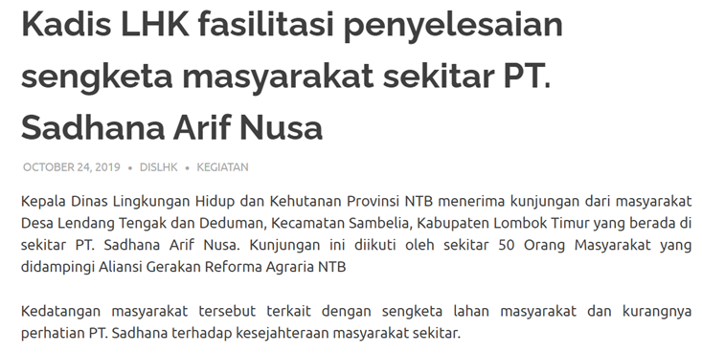
BACKGROUND
In the last decade up to 2010, Industrial Tree Plantation expanded rapidly at a global rate of 5 million ha annually (FAO 2010).
1986: Industrial Tree Plantation license began in Indonesia (SK Menhut No.320/Kpts -II/1986)
1990s: Industrial Tree Plantation (Hutan Tanaman Industri - HTI) developed massively in Indonesia.
11 million concession license (KLHK 2016)
Only 4.9 mio is effectively managed (KLHK 2016)
277 management units. Annual production 28 mio cubic meter kubik
Total asset HTI per quarter I/2015 up to IDR 43.164 trillion.
HTI expansion faced many criticisms related to land tenure, dissatisfaction towards the benefit-sharing mechanism, and negative impacts on environment (Ceanturi 2019).
“One reason for the planting shortfall lies with overlaps with community land” (Samsudin and Pirard 2014)
Reduced access for local community to acquire forest products (Iman 2000).
“Efforts to optimize utilization of the 10 million ha with HTI permits could increase the number of conflicts defined as “disagreements that lead to tension within, and between people” (Vestegaard et al. 2011).

Slide 3
Perceived ES importance
By local community
Most Important
Water Regulation (91%)
Agroforest products
(81%)
Challenges such as:
Mounting needs on various forest products and services,
Increasing interactions intensity among stakeholders in and around the forest,
The enactment of new regulations related to forest management, and
The emergence of problems pertaining to industrial forest management.
SK.256/Menhut-II/2011,
12 Mei 2011 around 3.810 Ha HTI in North Lombok, Central Lombok, and East Lombok.
Least Important
Natural NTFP (40%)
Timber (27%)
(Kim et al. 2016)
Local community’s perception and aspiration
are important in effective forest management
https://radarlombok.co.id/konflik-hti-sambelia-pt-sadhana-kembali-didemo-warga.html
Notes:
Hutan tanaman baru bersifat disruptif bagi masyarakat yang tinggal di di dekatnya karena berdampak pada ekonomi dan hubungan sosial selain pada lingkungan alami.
Oleh karena itu, tidak boleh diabaikan bahwa masyarakat lokal lantas akan memiliki sikap negatif terhadap hutan tanaman yang mengubah bentang alam mereka secara substansial jika harapan dan persepsi mereka tidak diperhatikan dalam rencana tata kelola hutan tanaman.

Slide 4
OBJECTIVES
To develop conceptual model for effective HTI management → reduced conflict, increased income
To perform simulations on the conceptual model
THIS STUDY
NEXT
Verify and validate model
Apply model on other forest management settings

Slide 5
SELECTED Method
Quantitative method using system dynamic approach was used in the model scenarios.

Slide 6
System Dynamics IS SELECTED BECAUSE:
Assist decision makers to:
Understand and analyze cause-effect (feedback) relationship of various parameters influencing various aspect of HTI management.
Assess the impacts of policy implementation in the future.
Understand the adverse and unpredictable impacts of policy.
Easy to understand and does not require complex mathematical equations.
Accommodate qualitative parameters
Facilitate participatory model development and provide communication forum for stakeholders.
Vensim software is used in HTI Management Effectiveness Model Analysis

Slide 7
GoalS of Ecosystem Service-Based HTI Management MODEL
Goal of Ecosystem Service-Based HTI Management
1. Formulate policy intervention on ecosystem service-based HTI Management.
2. Measure the impacts of ecosystem service-based HTI management policy intervention
Long Term (2030-2040)
Improve income from ecosystem services
Mid Term (2021-2030)
Effectivity of the HTI performance toward sustainable management.
Modelling simulation uses current sets of data and information to achieve the two goals mentioned above.

Slide 8
RESULTS

Slide 9
Conceptualization of variables relationship in ecosystem service-based HTI management :
Modelling Scope
Well-being
.
Industry &
Community
Trade offs
TIMBER
Effectiveness of HTI Management
Sustainable HTI Management Policy
Provision Service
Ecosystem Service-Based HTI
Cultural Service
Ecosystem Services Value
?
Supporting Services
Regulatory Service

Slide 10
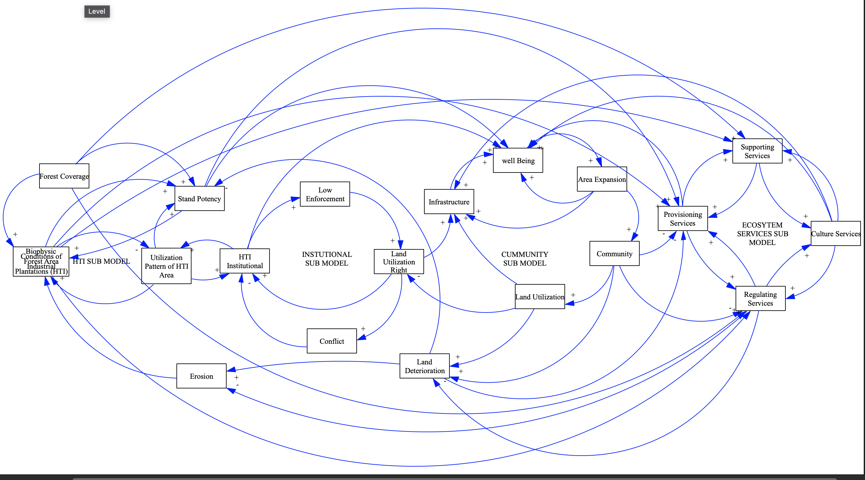
CAUSAL LOOP used to assess ecosystem service-based HTI management Model

Slide 11
Business as Usual
Revenue trend is timber-oriented. No intervention for ecosystem service (tourism service)
Results of Modelling Simulation (No intervention= 0 visitor)

Slide 12
Simulation 1 :
Revenue trend incorporating intervention on ecosystem service (tourism service), with 5,000 visitors per year.
Results of Modelling Simulation 1(5,000 visitors/year)

Slide 13
Simulation 2 :
Revenue trend incorporating intervention on ecosystem service (tourism service), with 10,000 visitors per year.
Results of Modelling Simulation 2 (10,000 visitors/year)

Slide 14
conclusion
In the ecosystem service-based HTI management conceptualization model, there are four (4) sub models influencing effective HTI management: HTI Sub Model, Institutional Sub Model, Community Sub Model, Ecosystem Service Sub Model.
Simulations showed that there is a significant difference between BEFORE intervention and AFTER intervention on the Trend of HTI Revenue, Total ES Revenue and Local Community’s Income.
This conceptual model can be useful as a tool for stakeholders to quantify trade-offs to inform management plan or policy process.
NEXT:
Verifying and Validating Model using real field data.
Testing model applicabity to other forest management regime

Slide 15
REFERENCE
Centaury. 2019. Pengusahaan Hutan: Hutan Tanaman Industri dan Hutan Alam. https://kmmh.fkt.ugm.ac.id/2019/05/28/pengusahaan-hutan-hutan-tanaman-industri-dan-hutan-alam/
Food and Agriculture Organization. 2010. Global Forest Resources Assessment 2010: Main report, FAO Forestry Paper 163. Rome: Food and Agriculture Organization.
Iman. 2000. Konflik antara Masyarakat Lokal dengan Perusahaan Hutan Tanaman Industri (Studi Kasus Masyarakat Desa Mentulik dan PT Rimba Seraya Utama, Kabupaten Kampar, Riau). IPB Repository. https://repository.ipb.ac.id/handle/123456789/23127
Kim, Y., Latifah, S., Afifi, M., Mulligan, M., Burke, S., Fisher, L.,… & Jennes, J. 2018. Managing Forest for Global and Local Ecosystem Services: A Case Study of Carbon, Water, and Livelihoods from Eastern Indonesia.
KLHK. 2016. "Jokowi Kaget Hutan Industri Kalah Luas dari Kebun Sawit", https://ekonomi.bisnis.com/read/20160203/99/515864/jokowi-kaget-hutan-industri-kalah-luas-dari-kebun-sawit. Author: Samdysara Saragih. Editor : Yusuf Waluyo Jati
Samsudin and Pirard. 2014. Conflict Mediation in Industrial Tree Plantation. CIFOR. https://www.cifor.org/publications/pdf_files/infobrief/5443-infobrief.pdf
Vestergaard B, Helvard E and Sorensen AR. 2011. Conflict Resolution - Working With Conflicts. Frederiksberg, Denmark: Danish Centre for Conflict Resolution.

Slide 16
THANK YOU

