Slide 1
THE WOOD INDUSTRY IN MALAYSIA AND THE NEED FOR HUMAN CAPITAL
MALAYSIAN TIMBER INDUSTRY BOARD (MTIB)
MR MOHD KHEIRUDDIN MOHD RANI
DIRECTOR GENERAL OF MTIB
WEBINAR ON “THE FUTURE OF WOOD SCIENCE AND TECHNOLOGY EDUCATION 2021”
27th MAY 2021

Slide 2
SCOPE OF PRESENTATION
STATUS OF MALAYSIAN TIMBER INDUSTRY
ISSUES AND CHALLENGES
WAY FORWARD
CONCLUSION

Slide 3
STATUS OF MALAYSIAN TIMBER INDUSTRY - 2020
EXPORT
CONTRIBUTION
3rd after palm oil and rubber
(2020: 14.63%)
FURNITURE INDUSTRY
Malaysia ranked 8th as furniture exporter
Export Value
RM22.02 billion ( 2.14%)
↓
Investment (2020)
RM759 million
Export Growth
Sawntimber 29.2%
Chipboard/Particleboard 27.4%
Wooden Furniture 16.2%
Plywood 16.5%
↓
Domestic
RM267.3 million
↑
↑
↓
FDI
RM491.7 million
Source: MIDA
Export Market
USA RM7,447 million
Japan RM2,734 million
China RM 2,250 million
Australia RM 878 million
Workforce
140,000
Value-added product
Peninsular 80.2%
Sabah 6.1%
Sarawak 2.2%
55% Foreign Labor
45% Local

Slide 4
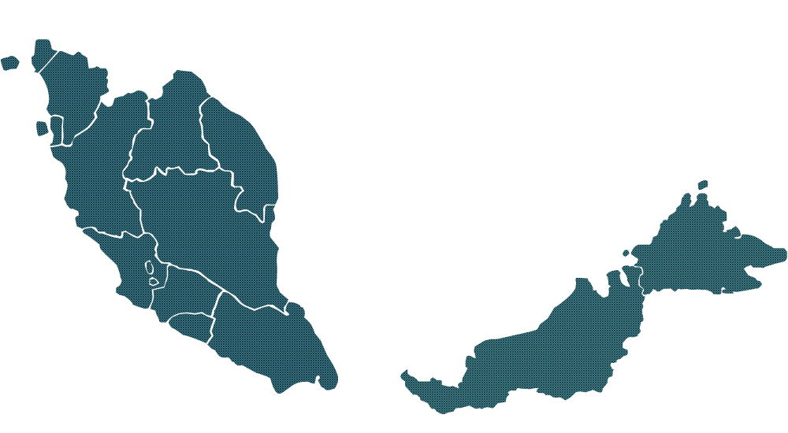
MALAYSIA: NUMBER OF MILLS, 2020
( MTIB’S CENCUS DATA)
TOTAL MALAYSIA: 1,901
Sabah
100
Sarawak
236
Peninsular
1,565
Plywood/ Veneer/ Polyply/ Blockboard/ Laminated Board
176
Builders’ Joinery & Carpentry (BJC)
66
Furniture
745
Kiln Drying/ Preservation Plants
39
Medium Density
Fibreboard (MDF)
7
Sawmills
587
*Others
(Wood Preservation,
Wood Pallet , Bamboo &
Rattan Furniture)
192
Mouldings
82
Woodchip/ Particleboard/ Chipboard
7

Slide 5
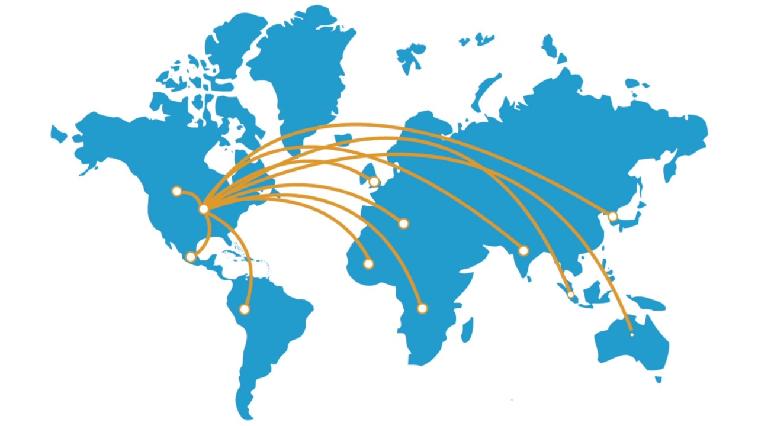
NATIONAL TIMBER INDUSTRY STRATEGIC PLAN (NTISP), 2021 - 2025
RM28 BILLION
EXPORT OF TIMBER AND TIMBER PRODUCT
TIMBER INDUSTRY TARGET BY 2025
RM20 BILLION
VALUE OF DOMESTIC MARKET
RATIO
68:32
VALUE-ADDED vs PRIMARY PRODUCT
BUMIPUTERA
DOMESTIC MARKET
EXPORT MARKET
10%
5%
THRUST 1
THRUST 3
Raw Material and Industry Sustainability
Human Capital and Productivity
THRUST 5
Strategic Thrust
THRUST 2
THRUST 4
Bumiputera Participation
Market Development
Technology, Innovation and Industry Support

Slide 6
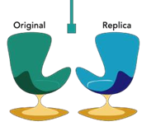
ISSUES AND CHALLENGES
Workforce in the timber industry
SUPPLY
DEMAND
Development of human capital (quality & quantity)
Industry sector-driven demand
Ensure strong pipeline of quality workforce into the labour market through education, TVET & upskilling
Key growth sectors in the 12 MP
Investments & creation of quality jobs in key growth sectors
Foreign workers - labor intensive - government policy
Automation & Mechanisation Technology – improve productivity
Population
Economic growth
Technology advancement
Innovation
New investment
New source of growth
Knowledge based economy
Slower growth
High migration
Towards ageing
Utilization/intake of local worker – 3D issues - low wages/salary
High skilled workers – capital intensive
Copycat furniture designers

Slide 7
WAY FORWARD
1
Transforming education to meet industry demand
2
Producing local skilled manpower
3
Improvement in terms of quality of training for youth
4
Collaboration between the industry and training institutions – e.g: Engineer Placement and Internship in industry Programme (EPIP)

Slide 8
FOCUS AREAS
Entrepreneur/
e-commerce
Engineered wood product
Timber engineering
MARKETING
FORESTRY
ENGINEERING
Forest plantation
Sustainable forest management
FUTURE NEED OF HUMAN CAPITAL
MATERIALS
TECHNOLOGY
Bio-composites
Wood & non-woods
Wood/Timber Machining
ICT/Robotic/Automation
Furniture & Interior design
Timber structure design
DESIGN
MANUFACTURING
Furniture manufacturing
GMP/ Lean management

Slide 9
TRAINING INSTITUTIONS/PROVIDERS IN MALAYSIA
Universiti Putra Malaysia (UPM) Universiti Teknologi MARA (UiTM) Universiti Sains Malaysia (USM) Universiti Malaysia Sabah (UMS)
Universiti Tun Hussien Onn Malaysia (UTHM)
Polytechnic
Industrial Training Institute MARA Skills Institute National Youth Skills Institute Community College Training Centre
MTIB / WISDEC
FITEC (MARA)
TTITC (Terengganu)
STIDC (Sarawak)
WOOD- BASED INDUSTRY
Vocational College School

Slide 10
CONCLUSION
1
Human capital development is vital for the future development of timber industry sector in Malaysia, in order to compete in the global market
2
Availability of adequate and quality human capital is critical and important in ensuring the continued development and progress of the industry
3
Greater capacity building efforts need to be undertaken in order to produce more skilled workforce and professionals
4
Therefore, the requirements for the development of human capital of the new generation must be strengthen in all formal institutions

Slide 11
THANK YOU
LEMBAGA PERINDUSTRIAN KAYU MALAYSIA (MTIB)

